Slide 1
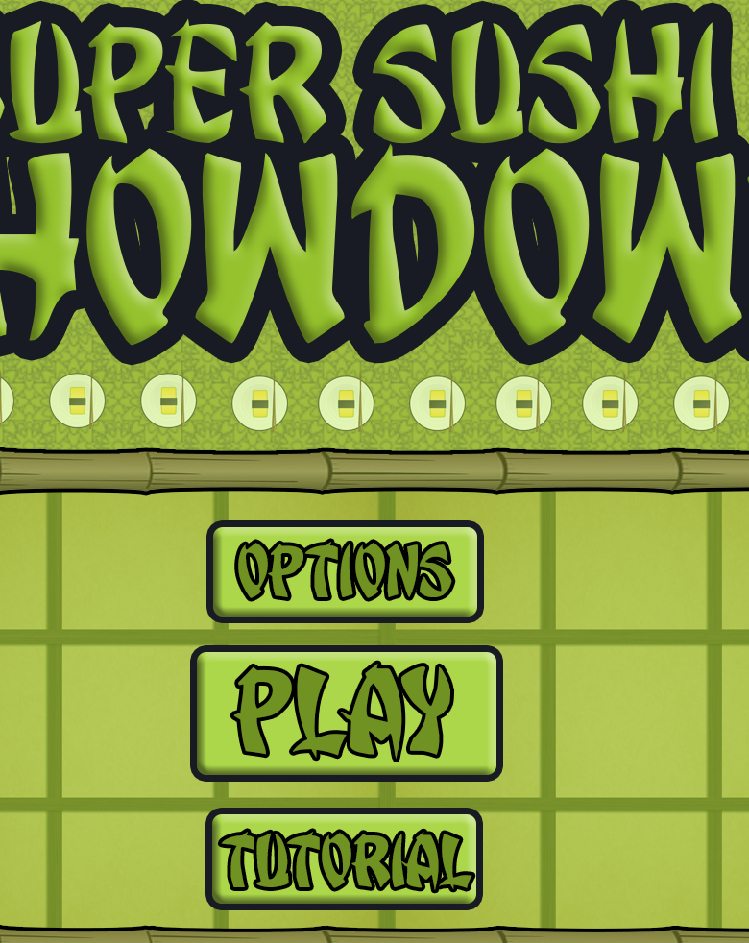
Bandai Namco Group 5 Second Pitch
Henry Crofts, Ashley Long, Samuel McMillan and Dawid Hojka

Slide 2
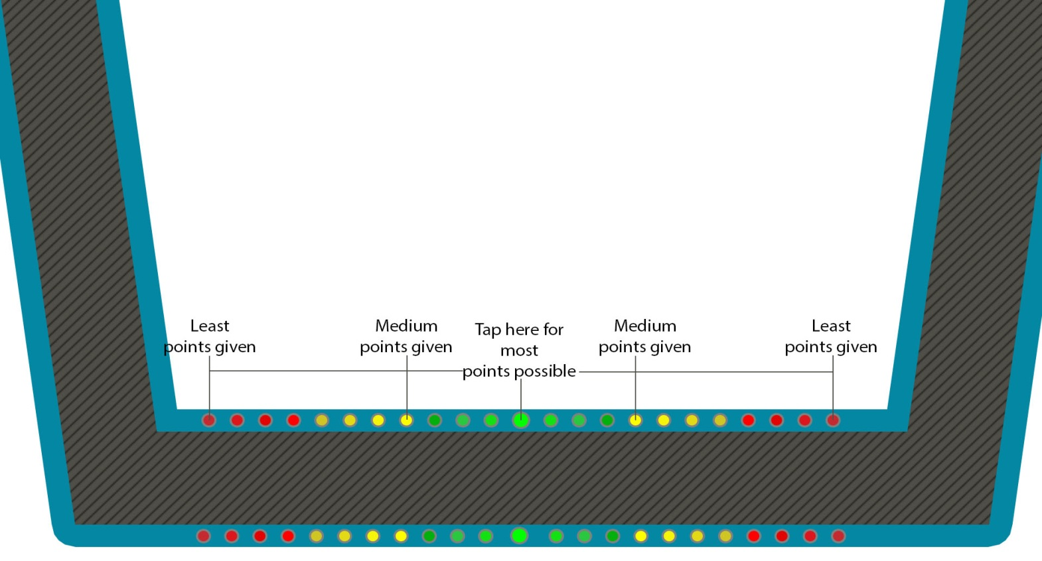
Brief Overview
Turn based
Adversarial
Twitch

Slide 3
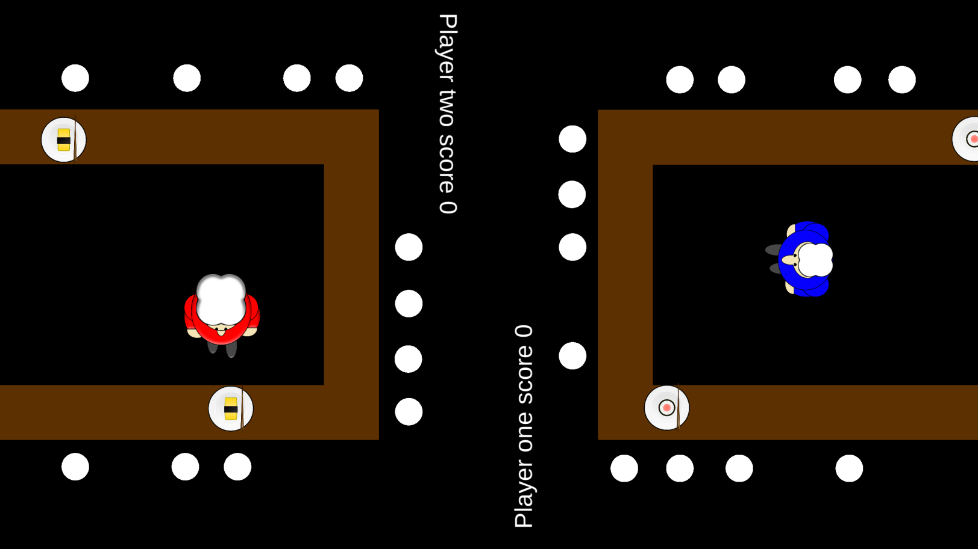

Latest Prototype / Features

Slide 4


What does the player do?
Core game loop
Player one begins play
Completes order
Turns switched

Slide 5
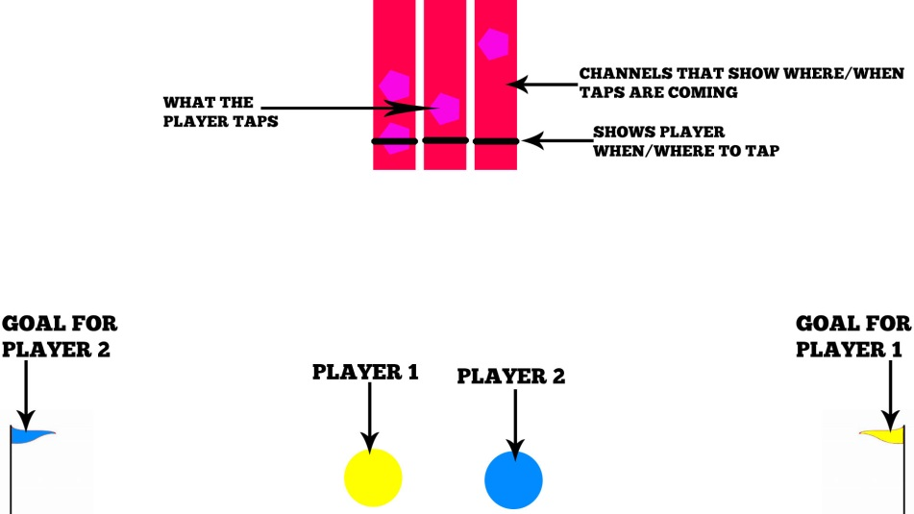
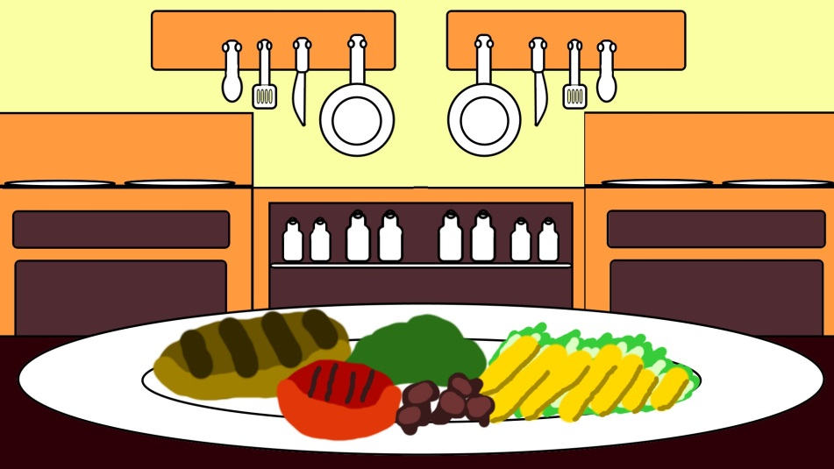
Iterations
Reverse Tug of War / Twitch
Tap falling nodes
Highest score wins
Side view

Slide 6
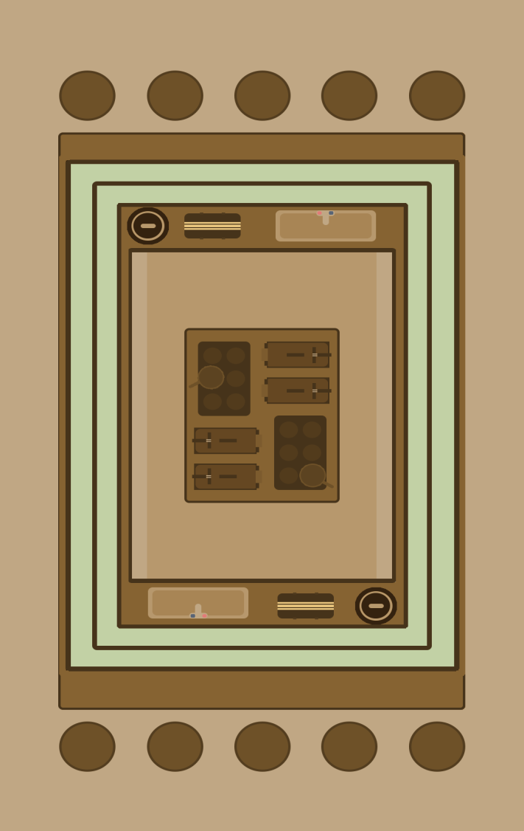
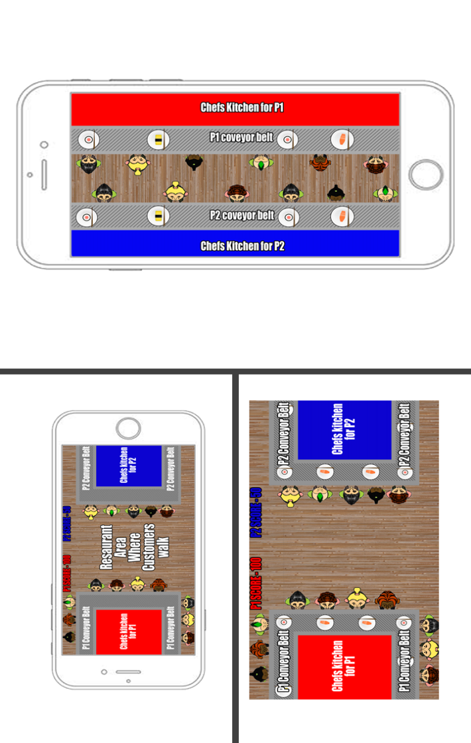
Iterations Continued
Sushi theme
Bring nodes into game

Slide 7
Where is the fun?
How do mechanics lead to fun?
How does theme lead to fun?
4 keys 2 fun?

Slide 8
Critiques
Chef feedback
Interaction between two players
Speed increase

Slide 9


Questions?

